Slide 1
Analyzing Daily
CO₂ Emissions
Across Countries
Anomaly Detection, Structural Breaks, Clustering & ML Forecasting

Slide 2




Our team
Daniele Cavuto
Parisa Izadyar
Economics student from Naples, Italy
IT Engineer from Rasht, Iran
Francesco Stellato
Aashi Mehrotra
Physics student from Naples, Italy
System Engineer from Modinagar, India

Slide 3
Analysis Roadmap
Step 1
Step 2
Step 3
Introduction
Data Preparation & Exploration
Anomaly Detection
Step 4
Step 5
Step 6
Clustering Analysis
Forecasting & Performance Comparison
Conclusions

Slide 4
Let’s get started!
We have a lot of great material to cover today so feel free to interrupt us and ask any question!

Slide 5
01
Introduction
Global CO₂ emissions are a key indicator of economic activity and environmental impact

Slide 6

Dataset Source
The dataset used in this project comes from Carbon Monitor – an open, continously updated initiative that provides near-real-time daily estimates of CO2 emissions across multiple contries and economic sectors
We downloaded the data from the official portal:
https://carbonmonitor.org/

Slide 7
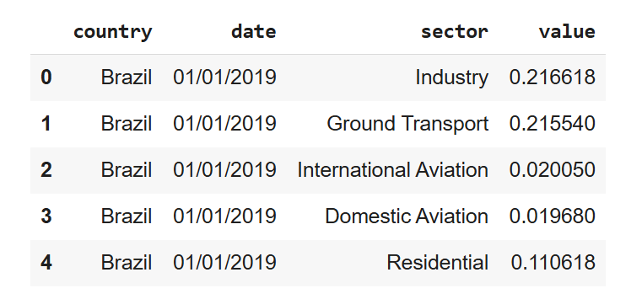
Dataset Info
The dataset contains 204,540 observations ranging from 1 January 2019 to 31 August 2025 and 4 variables:
Country;
Date;
Sector;
Value: daily CO₂ emissions in MtCO₂
There are no missing values. Therefore, we can aggregate the dataset by country, sector or date to analyze emission trends, sectoral contributions or global dynamics.

Slide 8
Analysis Objectives By Module
Data Mining
Machine Learning
We aimed to Identify hidden patterns and anomalies in daily emission. Techniques included:
SAX (Symbolic Aggregate Approximation)
Clustering of countries
CUSUM Test for Structural Break Detection
We deployed an advanced Machine Learning model for forecasting future emission trends (LSTM Neural Network).
Therefore, we quantified the model's reliability through a performance evaluation using standard metrics, such as Mean Absolute Error (MAE) or Root Mean Square Error (RMSE).

Slide 9
02
Exploring Data
Visualizing data is the key to transform raw numbers into clear, actionable insights

Slide 10
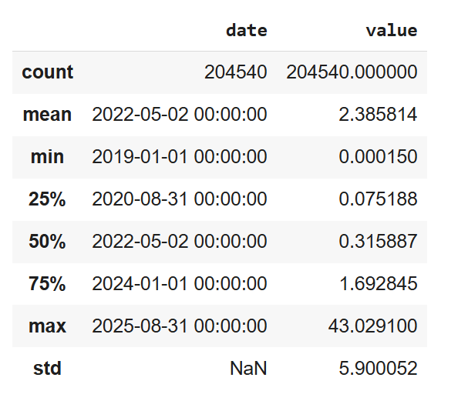
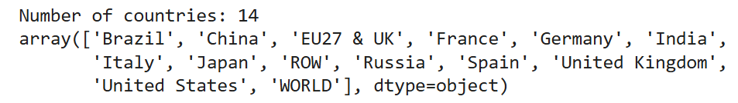
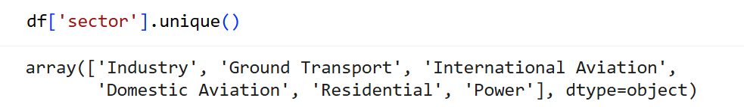
Data Descriptive Summary
The variable value (daily emissions in MtCO₂/day) shows a wide range — from nearly zero up to about 43 MtCO₂/day, with a mean of 2.39 and a high standard deviation (≈ 5.9), indicating substantial variability across countries and sectors.
The median (0.32 MtCO₂/day) is much lower than the mean, suggesting a right-skewed distribution, where most emissions are small but a few sectors or countries produce extremely large values.

Slide 11
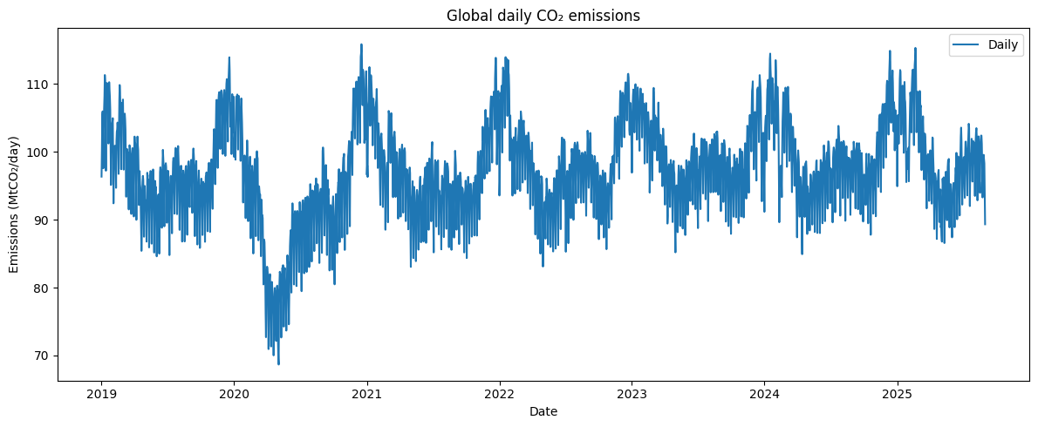
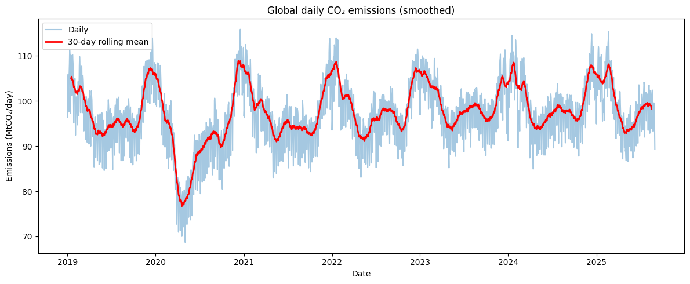
Visualizing Global Emissions using rolling mean
To better analyze structural changes in daily CO₂ emissions, we applied a 30-day Rolling Mean smoothing technique.
This process effectively reduces short-term noise and reporting variability, allowing us to highlight medium-term trends and seasonal patterns while preserving overall temporal solution.

Slide 12
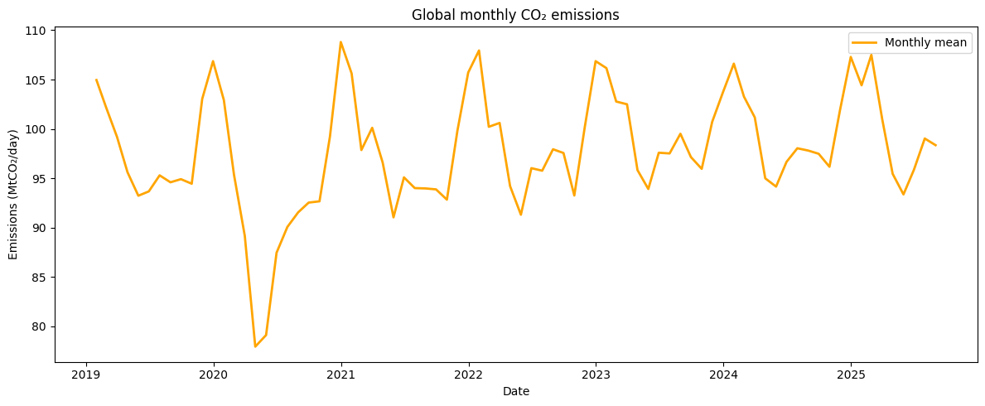
Visualizing Global Emissions using aggregation
To facilitate even more long-term analysis, the data may be aggregated by month.

Slide 13
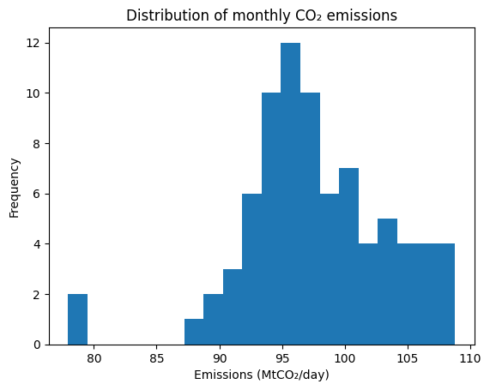
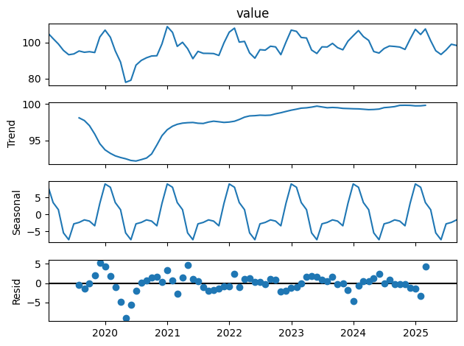
Monthly Data Analysis
From the hystogram, it can be observed that monthly CO₂ emissions follow a stable distribution:
Unimodal
Slightly right-skewed distribution
Few lows linked to COVID-19 slowdown
From the second image, it can be observed that global CO₂ emissions show clear seasonal patterns and limited random fluctuations:
Strong seasonal component
Low irregular noise
Reliable base for anomaly detection

Slide 14
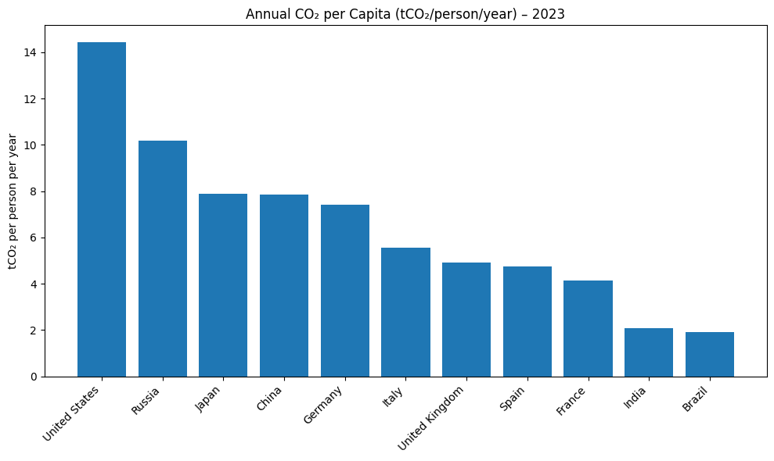
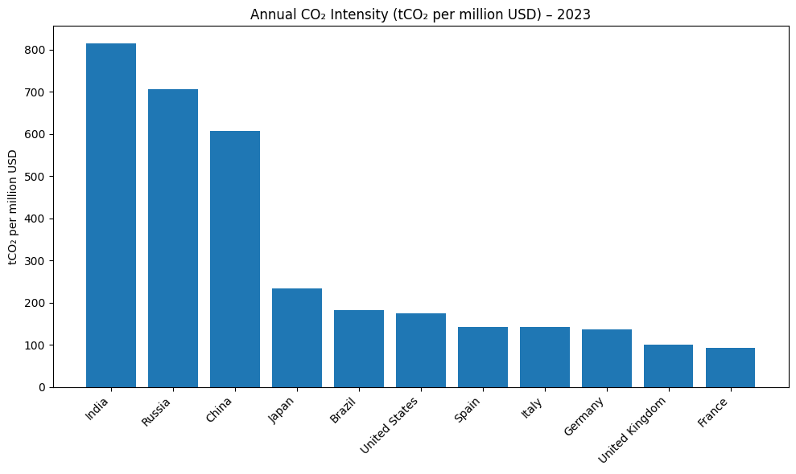
Normalized Emissions
To make cross-country comparisons meaningful, we constructed a new dataset that expresses CO₂ emissions relative to key socioeconomic indicators:
Population
Gross Domestic Product (GDP)
Population and GDP data are retrieved automatically from the World Bank Open Data API (via the wbgapi Python package).

Slide 15
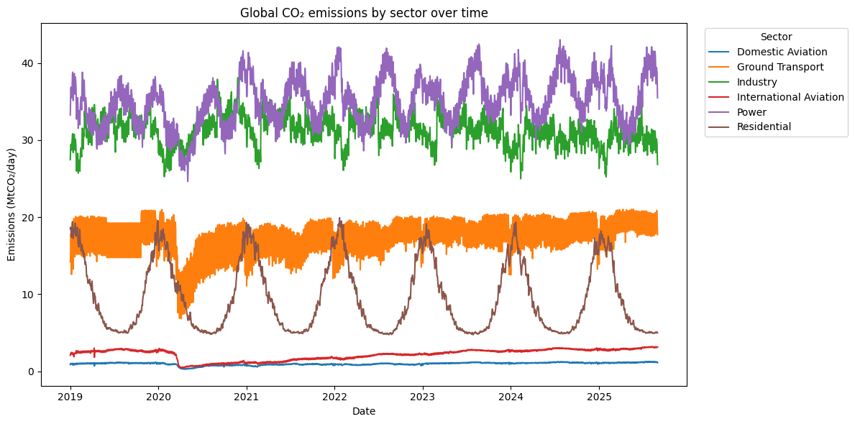
Global Emissions by Sector
Power and Industry are the dominant sources of emissions;
Ground Transport remains relatively stable but shows a visible drop during early 2020 (COVID-19);
Residential emissions display a strong winter seasonality, peaking each year due to heating demand;
Domestic and International Aviation emissions are much lower in magnitude but exhibit a similar pandemic-related collapse in 2020, gradually returning to pre-crisis levels.

Slide 16
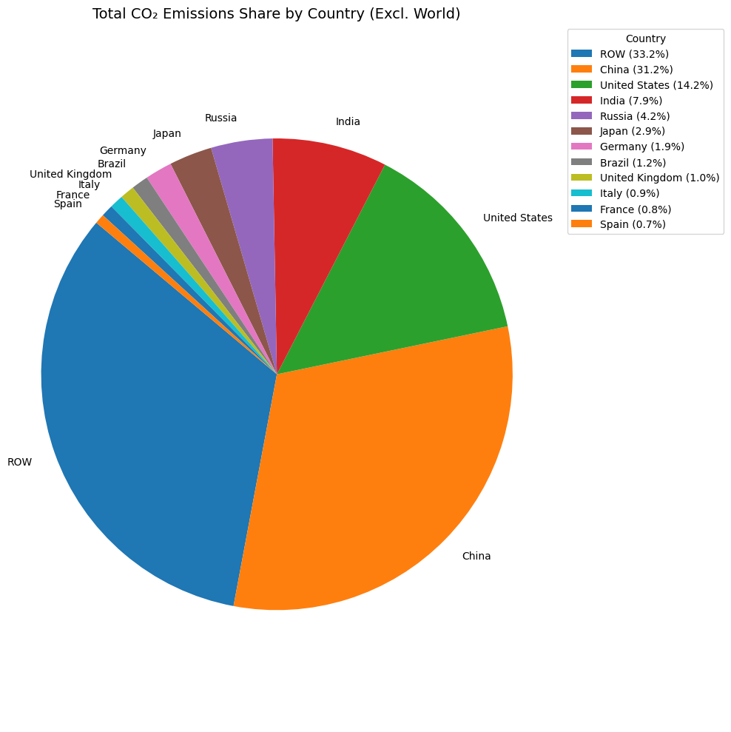
Global Emissions by Country
The pie chart displays the share of total CO₂ emissions contributed by each country:
China (31.2%) and the Rest of the World (ROW, 33.2%) together account for nearly two-thirds of global emissions, emphasizing their dominant roles;
The United States contributes 14.2%, followed by India (7.9%), Russia (4.2%), and Japan (2.9%);
European countries such as Germany, the United Kingdom, Italy, France, and Spain each account for less than 2%, highlighting their comparatively smaller shares.
Overall, the figure shows a high concentration of emissions in a few major economies.

Slide 17
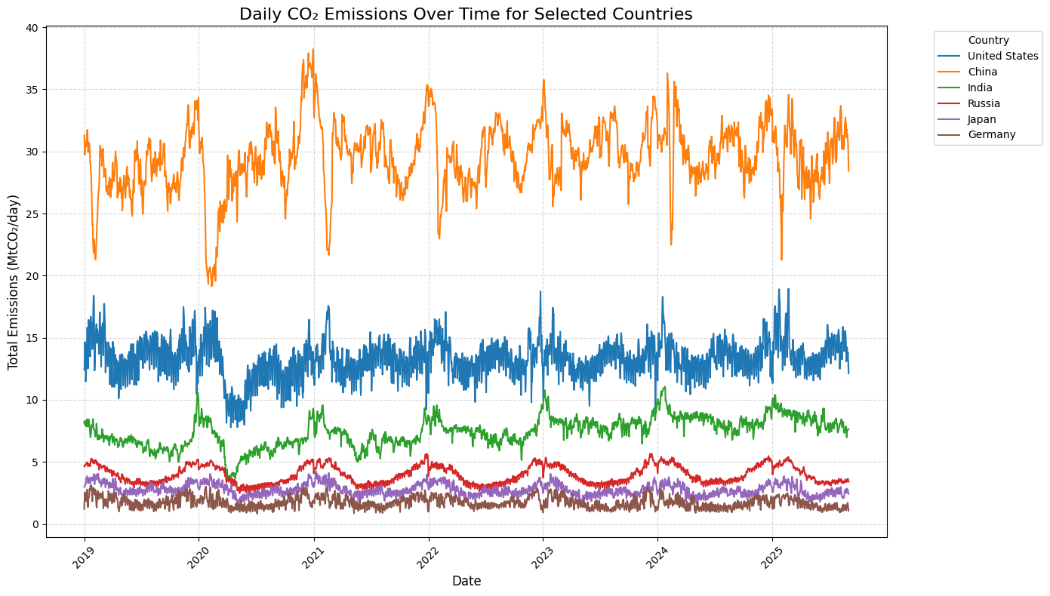
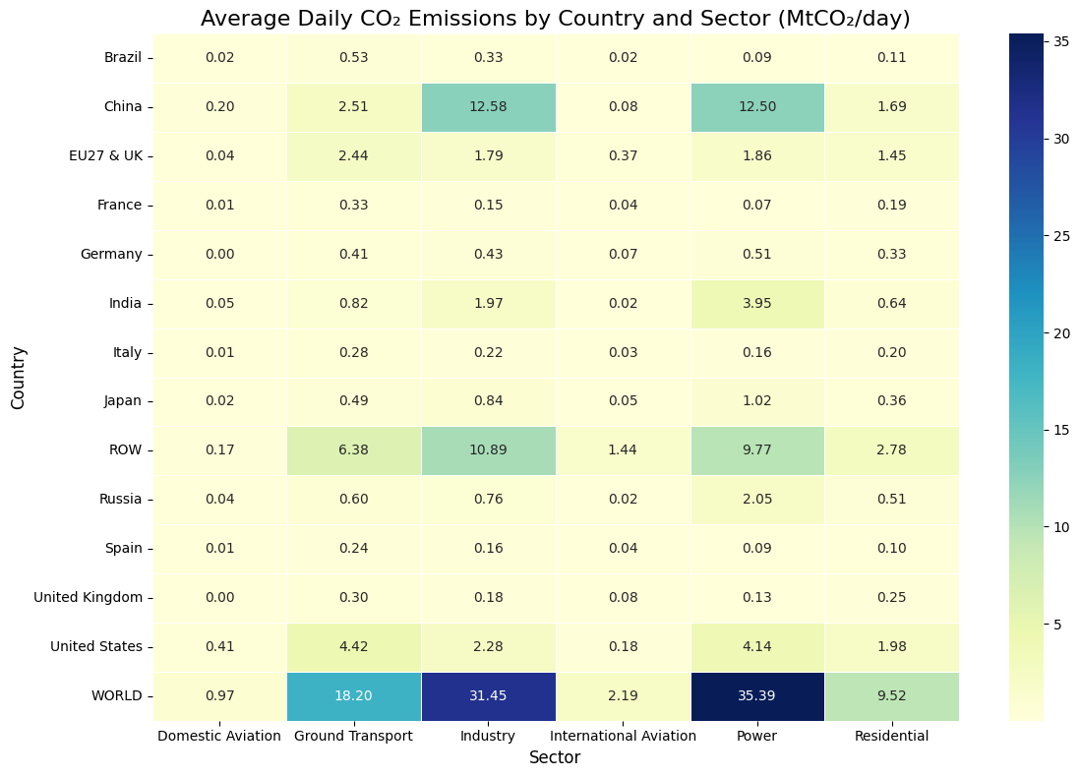
Visualizing Emissions by Country
The figure shows the daily evolution of CO₂ emissions (MtCO₂/day) from 2019 to 2025 for six major emitters: China, the United States, India, Russia, Japan, and Germany.
This heatmap shows the average daily CO₂ emissions (in MtCO₂/day) for each country–sector pair

Slide 18
03
Anomaly Detection
Detecting unusual emission patterns through data-driven anomaly identification.

Slide 19
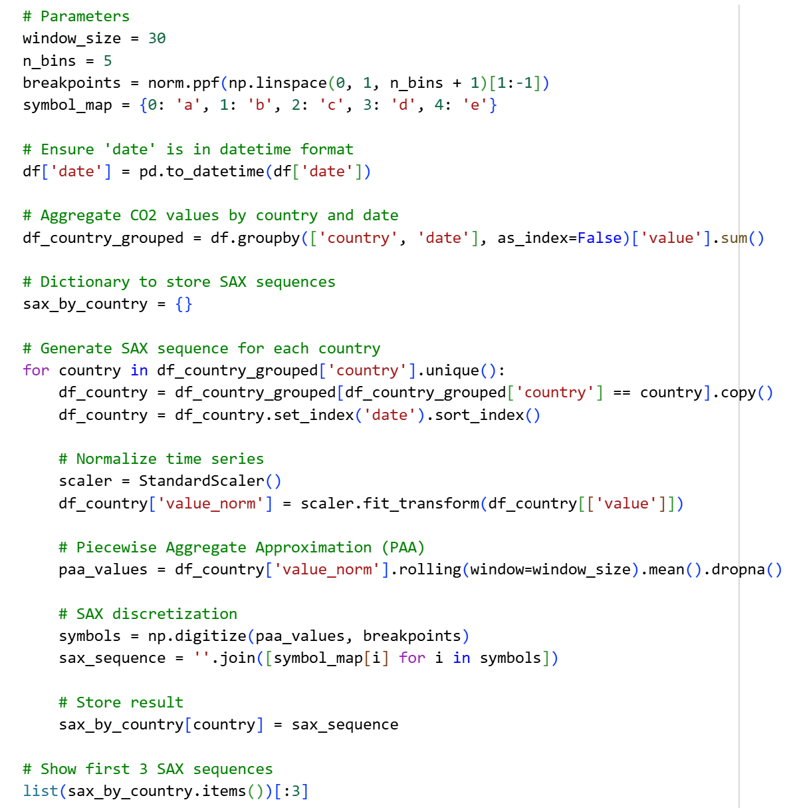
Introducing SAX
To analyze temporal patterns of CO₂ emissions in a more compact and comparable way, we applied the Symbolic Aggregate approXimation (SAX) method.
SAX converts each country’s time series into a symbolic representation by:
Normalizing the series (zero mean, unit variance);
Smoothing the signal via a rolling mean (Piecewise Aggregate Approximation, PAA);
Discretizing the smoothed values into a small set of bins based on normal distribution breakpoints;
Mapping each bin to a symbol (from ‘a’ to ‘e’).

Slide 20
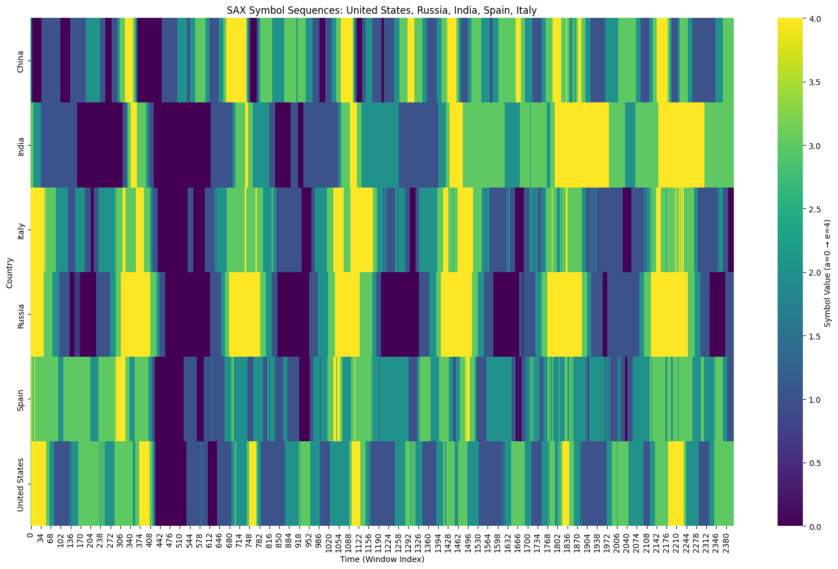
Plotting SAX Sequences (Heatmap)
The heatmap shows the evolution of these symbolic sequences over time, where colors represent the relative emission levels within each country's historical context.

Slide 21
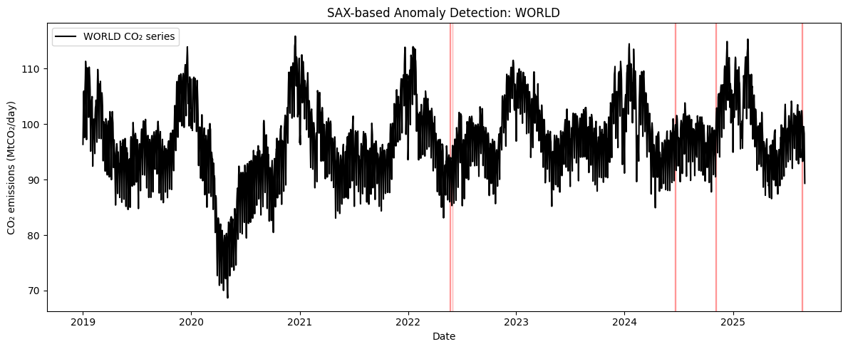
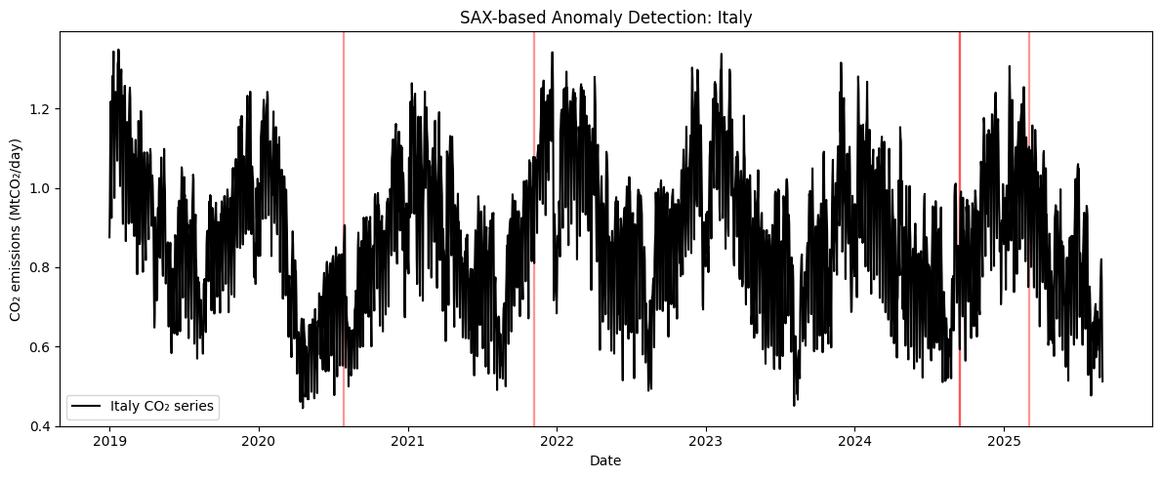
Anomaly Detection by using SAX
Basing on the Symbolic Aggregate approXimation (SAX) representation, we apply an anomaly detection technique. After converting each country’s CO₂ emission time series into symbolic sequences (with symbols from a to e), we search for unusual patterns that rarely occur in the historical data.
We split each symbolic sequence into small overlapping patterns of length n (called n-grams).
We estimate the frequency of each pattern across all countries and compute its probability with Laplace smoothing.
Each window of the series receives an anomaly score equal to the negative logarithm of its pattern probability ( − log p ). The higher the score, the more unusual the local behavior of emissions.
We then identify and visualize the top-k anomalous windows (the rarest symbolic patterns) for both the global emissions (WORLD) and a selected country (Italy).

Slide 22
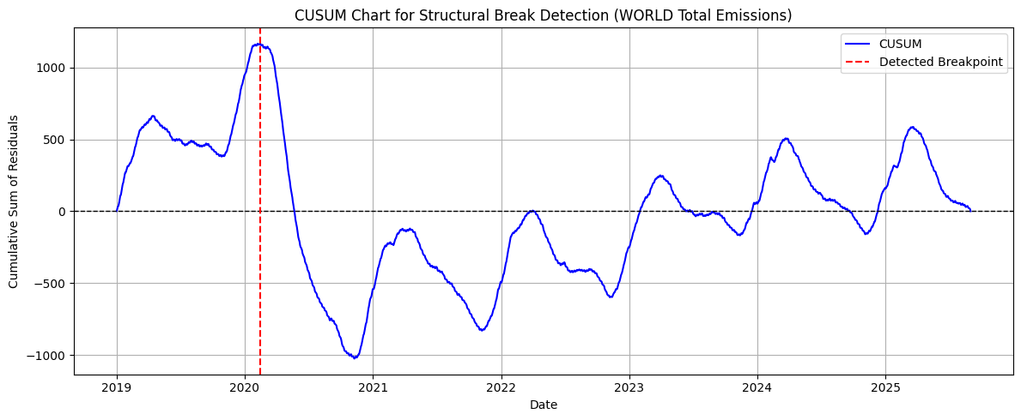
Structural Break Detection using CUSUM test
The CUSUM (Cumulative Sum of Residuals) test was used to detect structural breaks in the global CO₂ emission trend.
The method fits a linear model and checks if the cumulative sum of residuals deviates significantly from zero, which is shown by crossing the 95% confidence bands.
A major breakpoint was detected in early 2020, consistent with the sharp drop in emissions during the COVID-19 lockdowns. Following this point, the CUSUM statistic stabilized, indicating a new emission regime.

Slide 23
04
Clustering Analysis
Two complementary clustering approaches are explored basing on:
Temporal Evolution of Emissions
Magnitude of Emissions

Slide 24
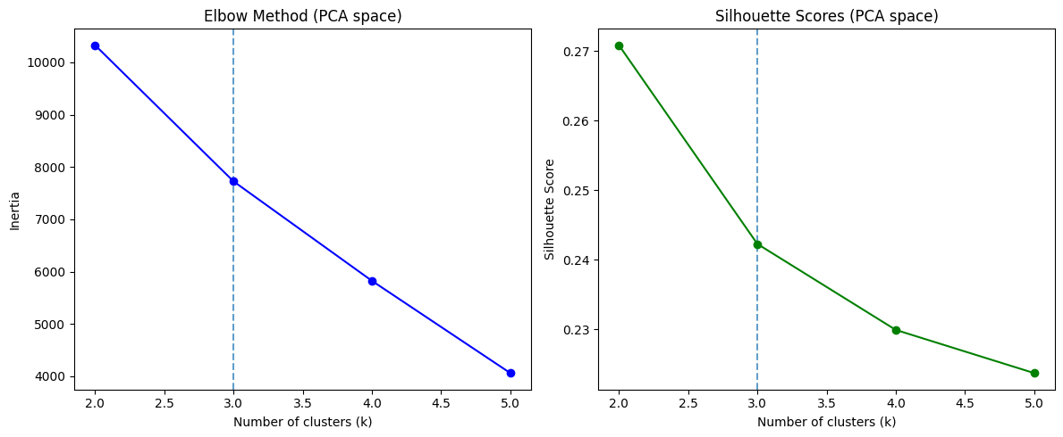
Clustering analysis based on temporal evolution of emissions
Time series were first standardized (z-score) to remove differences in magnitude, focusing the analysis on relative temporal fluctuations;
Principal Component Analysis (PCA) was then applied to the standardized data to reduce dimensionality while retaining 95% of the variance;
Finally, the K-Means algorithm was used on this reduced representation to identify clusters of countries with similar emission trajectories;
The optimal number of clusters was determined by combining the Elbow and Silhouette methods, balancing compactness, separation, and interpretability.

Slide 25
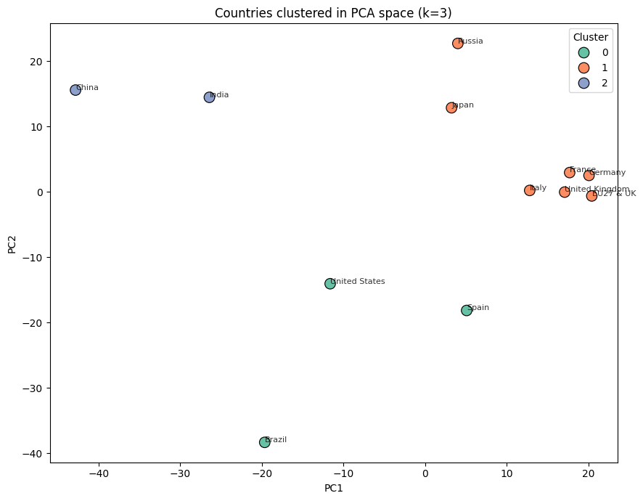
K-Means Clustering
The cluster composition reveals three interpretable groups:
Cluster 0 (United States, Spain, Brazil):
Countries characterized by similar temporal emission dynamics, showing pronounced decreases during the COVID-19 lockdowns followed by gradual recovery and moderate variability.
Cluster 1 (Russia, Japan, Italy, France, Germany, United Kingdom, EU27 & UK):
Industrialized economies with relatively stable and synchronized emission patterns, reflecting comparable responses to global events and seasonal variations.
Cluster 2 (China, India):
Large emerging economies with distinctive upward trends and stronger fluctuations in emission intensity over time.

Slide 26
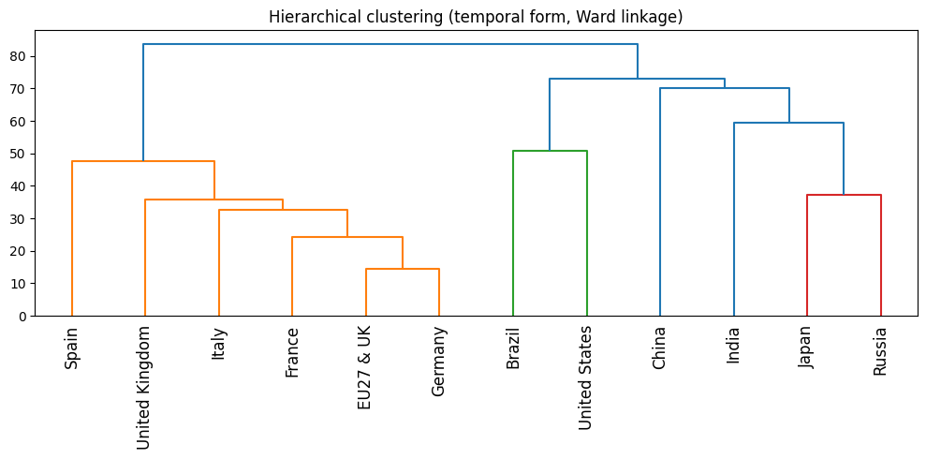
Hierarchical Clustering
To further validate the temporal grouping of countries, hierarchical clustering was applied to the same standardized time-series.

Slide 27
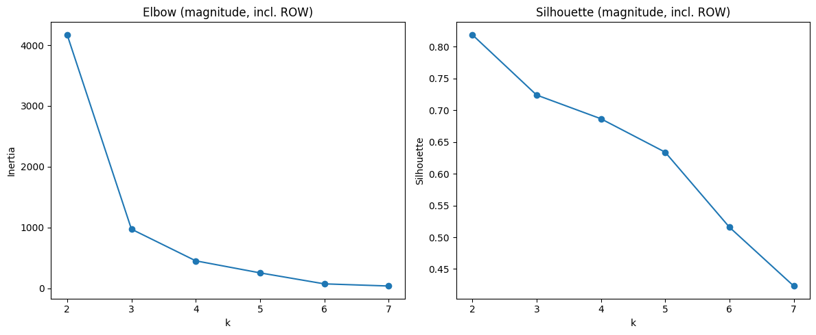
Clustering analysis based on emissions magnitude
Unlike the previous section, where time series were standardized to highlight relative temporal patterns, the data here are globally scaled with a StandardScaler to preserve differences in emission intensity.
This method groups countries with similar overall emission levels and variability, regardless of when fluctuations occur.
The Elbow inflection at k ≈ 4 offers a balanced solution, providing enough detail to distinguish high, medium, and low-emission groups, while maintaining a coherent global structure that includes the aggregated ROW entity.

Slide 28
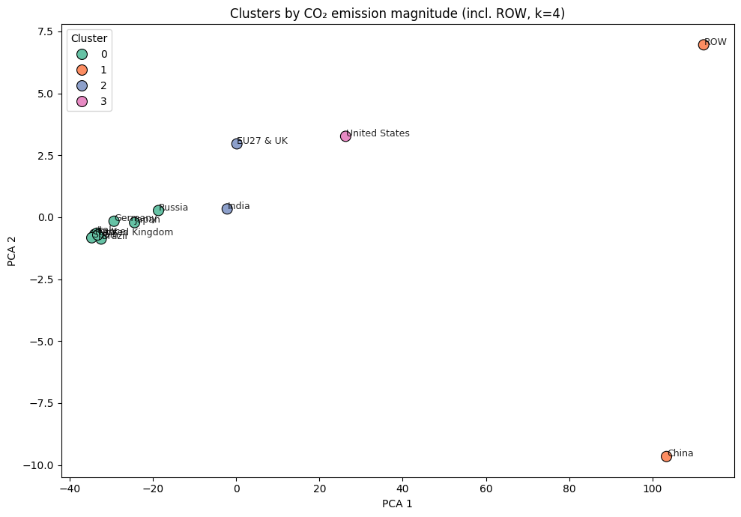
K-Means Clustering (2)
The cluster composition reveals four interpretable groups:
Cluster 0 (8 countries – e.g., Germany, France, UK, Italy, Brazil):
Represents low-to-medium emission economies, generally characterized by stable and moderate CO₂ outputs.
Cluster 1 (China and ROW):
Contains the largest emitters globally, showing extremely high absolute emission levels that dominate global totals.
Cluster 2 (India and EU27 & UK):
Includes intermediate emitters, bridging the gap between industrialized regions and emerging economies.
Cluster 3 (United States):
Forms a distinct group due to its persistently high emissions but with variability patterns different from China and ROW.

Slide 29
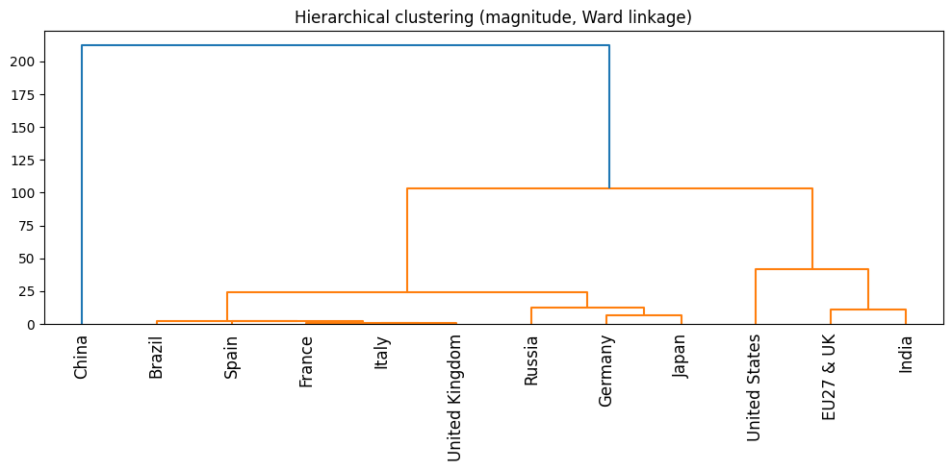
Hierarchhical Clustering
The dendrogram isolates China as a standalone cluster due to its vastly higher emissions. The high silhouette score (0.736) reflects this sharp divide, highlighting the dominance of a single global emitter rather than a meaningful multi-cluster structure.

Slide 30
05
ML Forecasting Model
We implemented a Long Short-Term Memory (LSTM) neural network to forecast future emission trends, both at the global level and for selected countries, providing a predictive perspective that complements the exploratory insights.

Slide 31
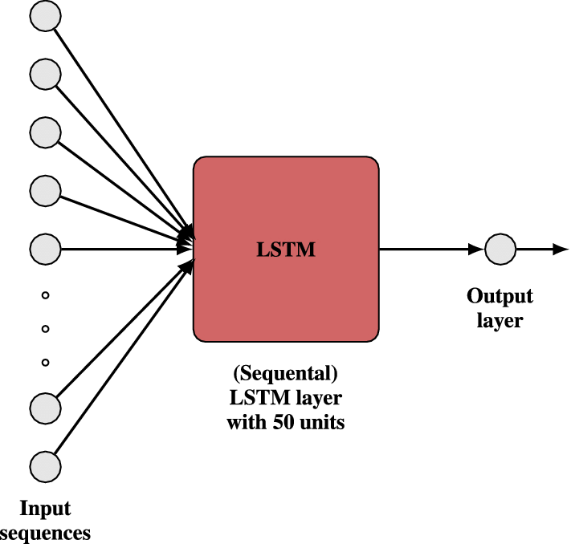
Introducing LSTM
A Long Short-Term Memory (LSTM) network was developed to forecast daily CO₂ emissions using 30-day input sequences.
Data were scaled with a MinMaxScaler and split into 80% training and 20% testing sets.
The model includes one LSTM layer (32 units), a 20% dropout layer, and a dense output neuron, trained with the Adam optimizer and MSE loss.
Early stopping was applied to avoid overfitting.

Slide 32
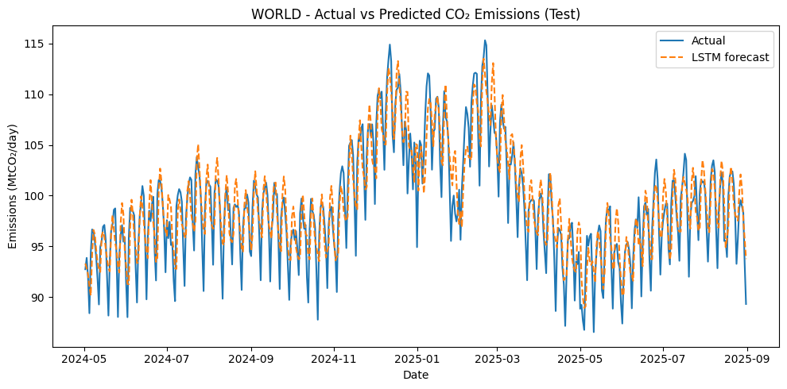
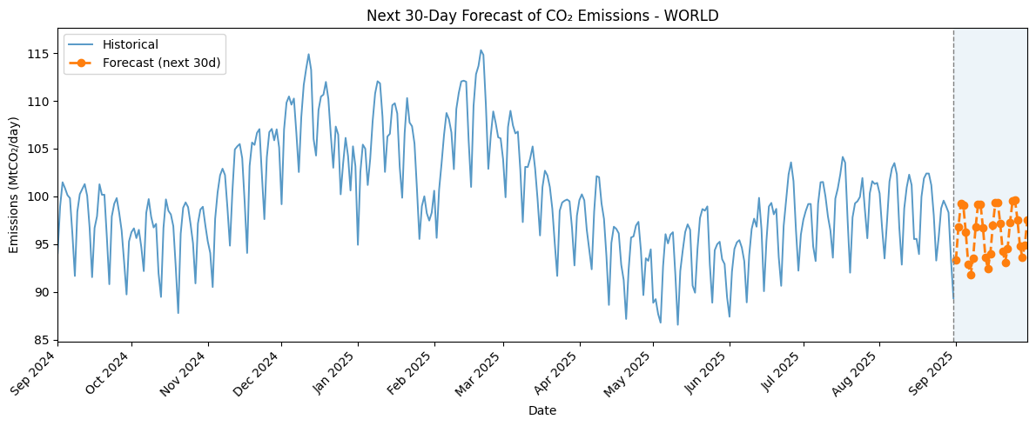
Plotting LSTM for World
The LSTM model achieved strong predictive performance:
RMSE = 2.60 MtCO₂/day
MAE = 2.09 MtCO₂/day
MAPE = 2.1%
It reproduces both seasonal trends and high-frequency variations, with minor errors around sudden peaks and drops. The 30-day forecast extends the trend smoothly, indicating short-term stability and confirming the model’s effectiveness in modeling CO₂ emission dynamics.

Slide 33
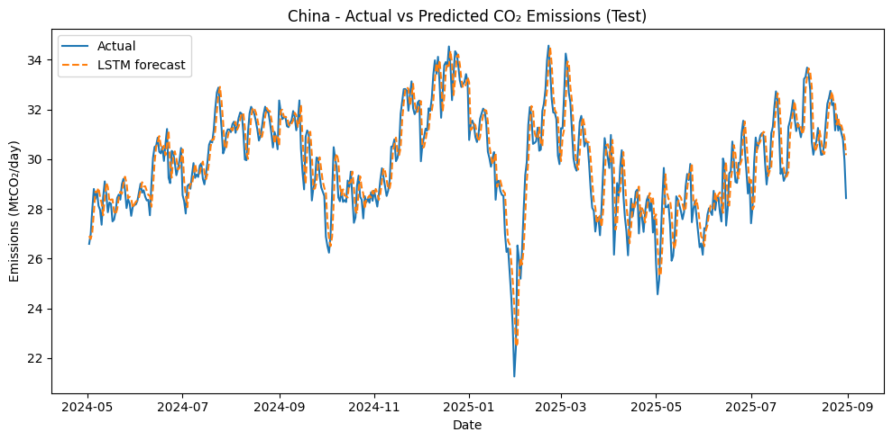
Plotting LSTM for China

Slide 34
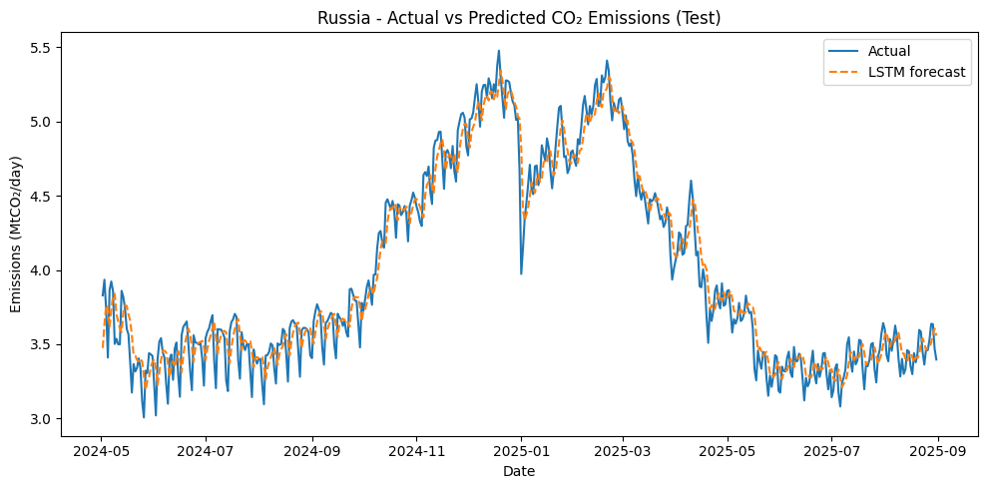
Plotting LSTM for Russia

Slide 35
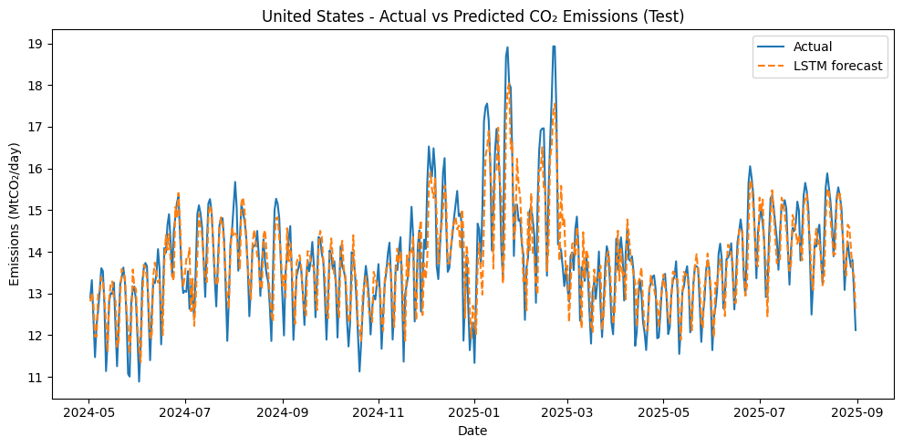
Plotting LSTM for USA

Slide 36
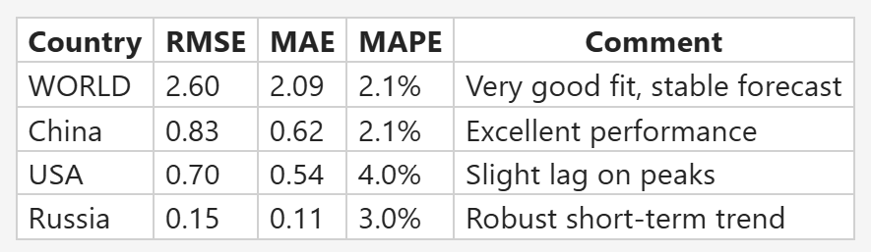
Final Remarks on LSTM Forecasting
LSTM models applied across global and national levels (China, U.S., Russia) effectively captured short-term CO₂ emission dynamics, with low errors (MAPE 2–4%) and predictions closely matching observed trends.
Global and Chinese models showed the best fit, while U.S. and Russian models remained reliable with minor deviations near peaks.
Overall, LSTMs proved capable of learning temporal dependencies in emission data, though future work could enhance performance by extending forecast horizons and integrating external variables.

Slide 37
Thanks!
Do you have any questions?

